Slide 1
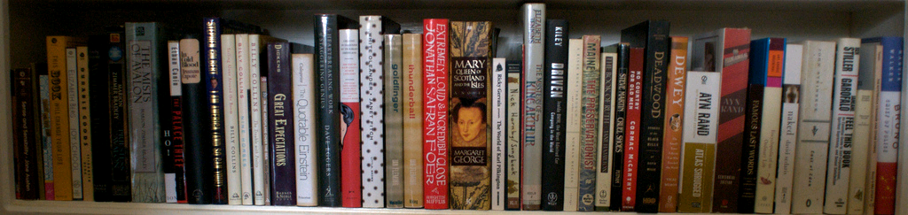

JSRCC Library
image from Flickr User eloquentlight's photostream
Your First Stop for Information and Research Needs
http://library.reynolds.edu

Slide 2
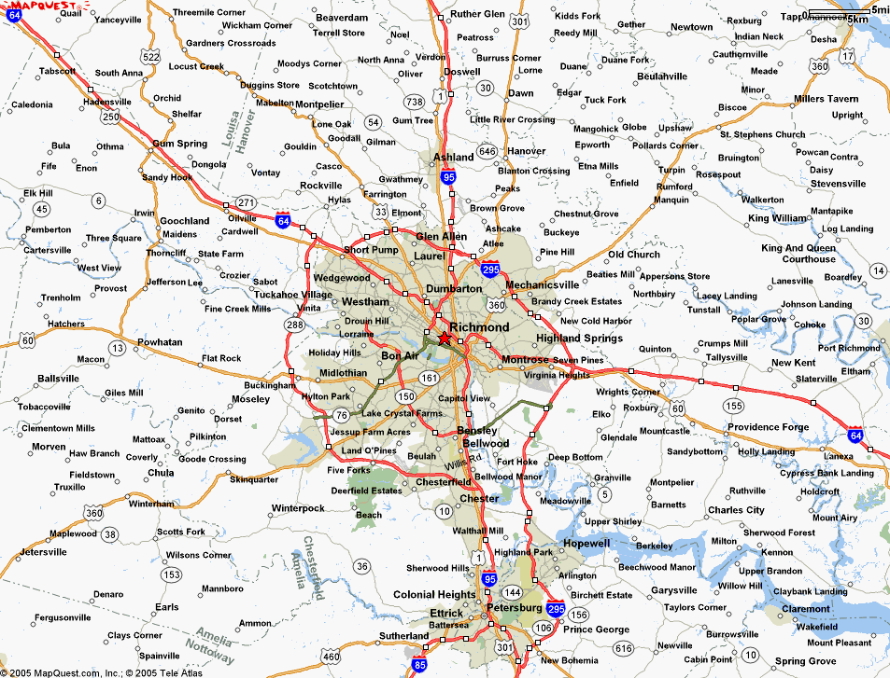
Where can you find us?
http://library.reynolds.edu
Goochland
Parham
Downtown

Slide 3
What do we have for you?
Books
Periodicals
Videos
Audio Books
Print: 90,000
Online: 40,000
Print: 400
Online: 50,000
DVDs: 3250
Online: 1000
Disc: 700
Online: 8750
Other Collections:
ESL
Career
Juvenile
Educational & Popular
Notes:
According to the survey conducted by OCLC….

Slide 4
Books
Total: 130,000
Sign up for Books Unlimited workshop to learn more about reading and downloading ebooks …

Slide 5
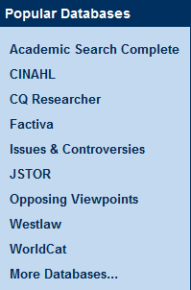
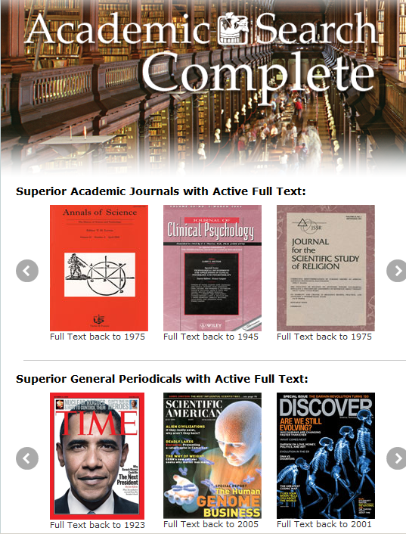

Periodicals

Slide 6
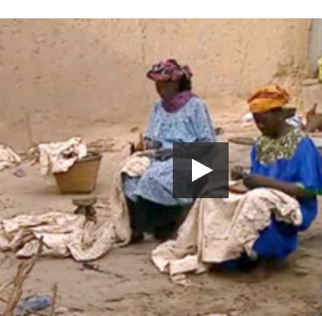
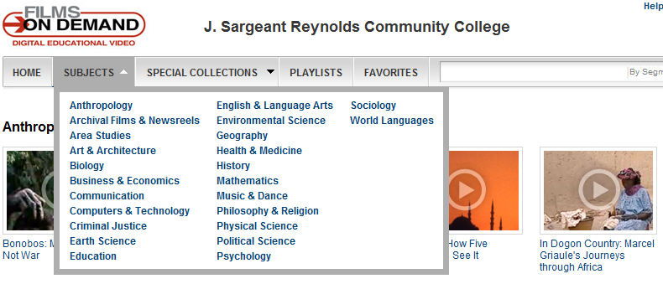
Videos: Online & DVD
Over 8750 online educational videos & 3250 popular DVDs

Slide 7
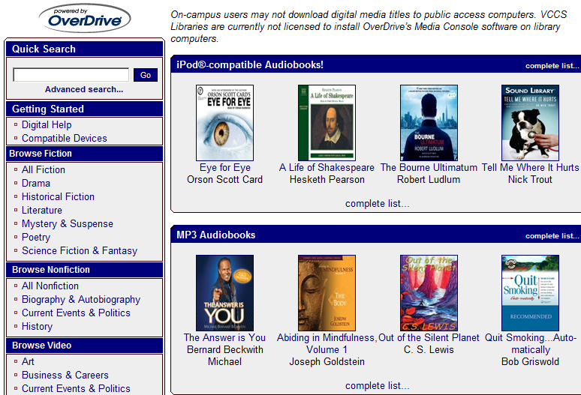
Audio Books: Online & Discs
Over 1000 online audio books with OverDrive and about 700 books on Discs

Slide 8

Reminder:
You can access our online resources 24/7 from both on- and off-campus
“MyJSRCC” login is your key to enter our online databases from off-campus
Attend Beyond the Textbook: Integrating Library Resources into Blackboard workshop to learn how to link online articles, ebooks or videos from Blackboard
Notes:
Image: http://www.123rf.com/photo_364562_around-the-clock.html
http://www.123rf.com/photo_1438015_gold-key-under-sun.html
Photo credit: http://www.onemedical.com/bos/how-we-work

Slide 9

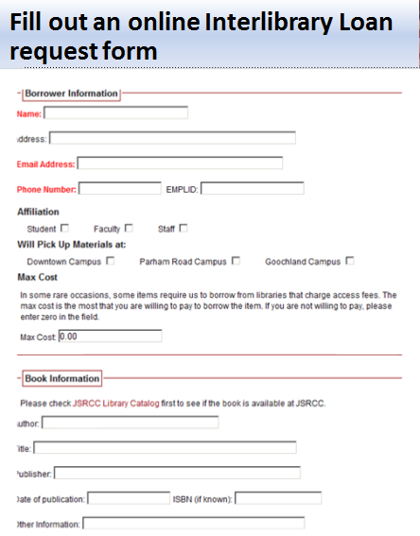

Beyond the Library…

Slide 10

What can we do for you?
ACRL Information Literacy Standards
F2F
Open Session Library Workshops
Customized Library Instruction
Online
LibGuides
Research at Reynolds Libraries
Assessment
Notes:
Photo: http://ascplcl.wordpress.com/parents-and-educators/information-literacy-resources/

Slide 11
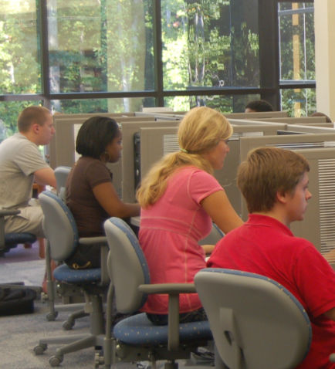
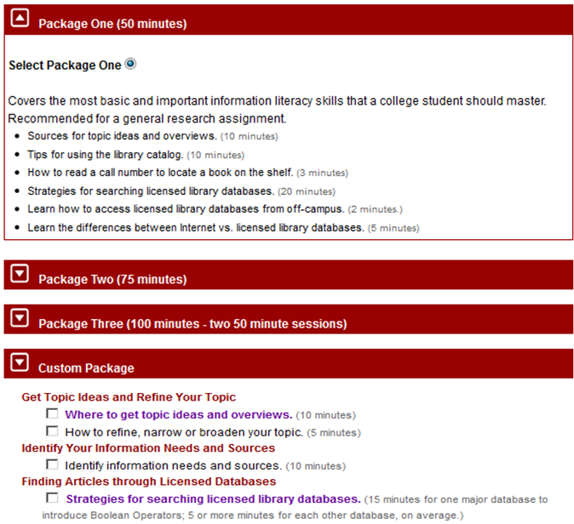
Customized Library Instruction Packages

Slide 12
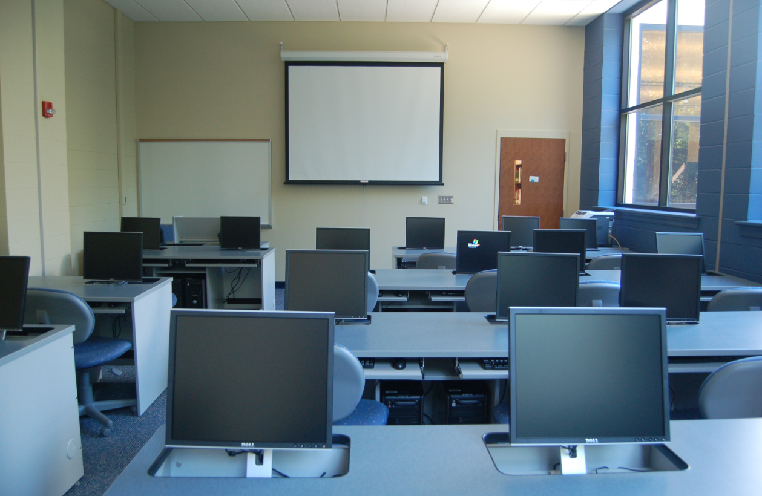
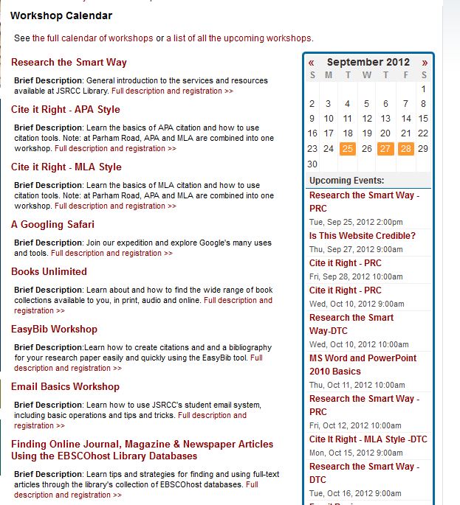
Open Session Library Workshops

Slide 13
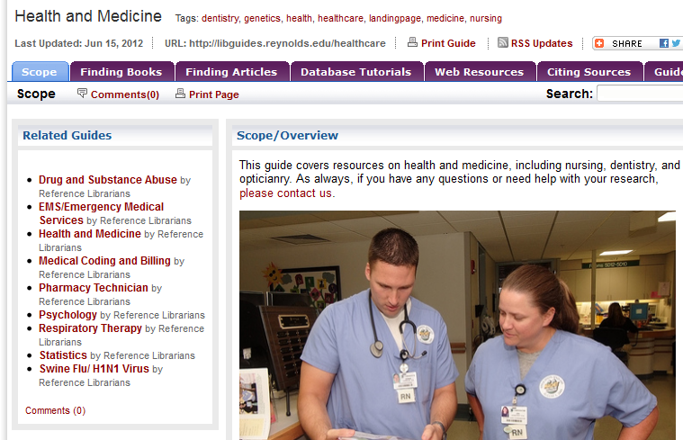
Course/Assignment/Subject-based LibGuides

Slide 14
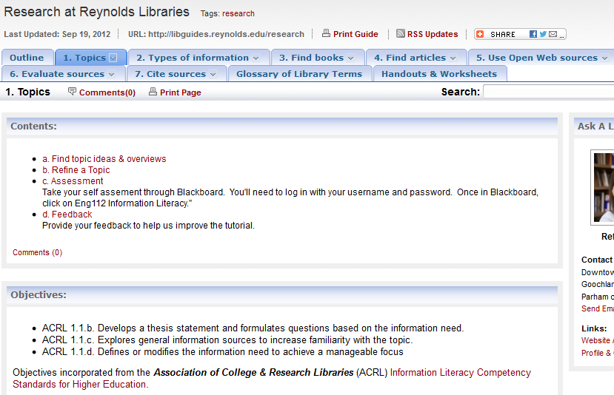
Research at Reynolds Libraries Online Modules

Slide 15
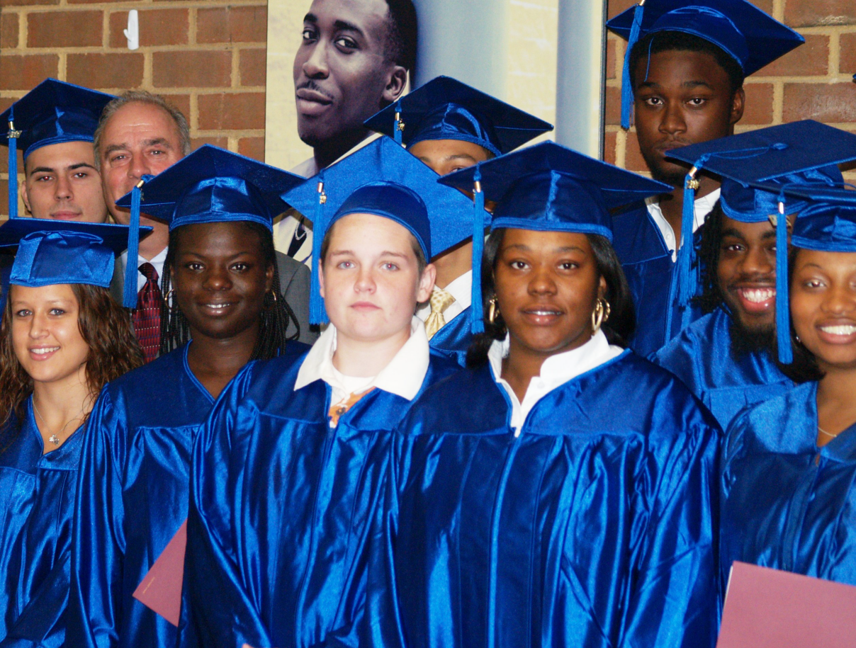
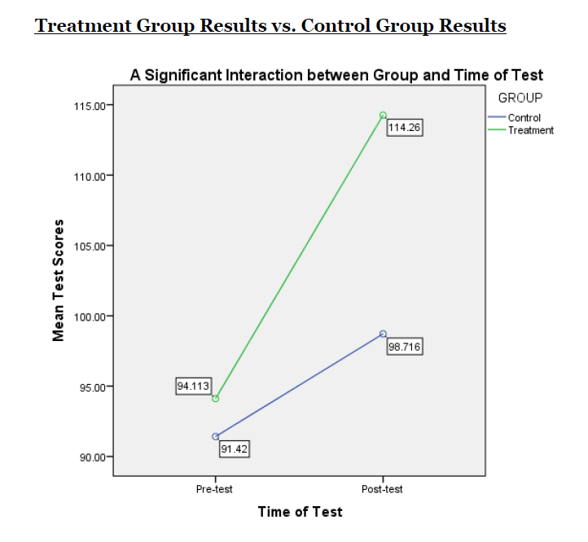
Impact of Integration of Online Modules

Slide 16
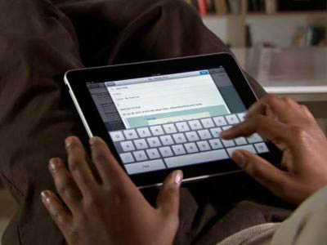
Testimony from a student…
Hey Mr. JSRCC Instructor,
Just wanted to let you know that at JMU we had to take a information skills test and go through all of these modules. I didn't even have to go through any of the modules because we already did basically the same thing in your class this spring. Passed with scores of 4,4,5,4 and 4 out of 5.
Thanks!!!!!!!!
Former JSRCC Student
Notes:
Photo:http://www.businessinsider.com/all-time-top-10-free-ipad-apps-2011-1?op=1

Slide 17
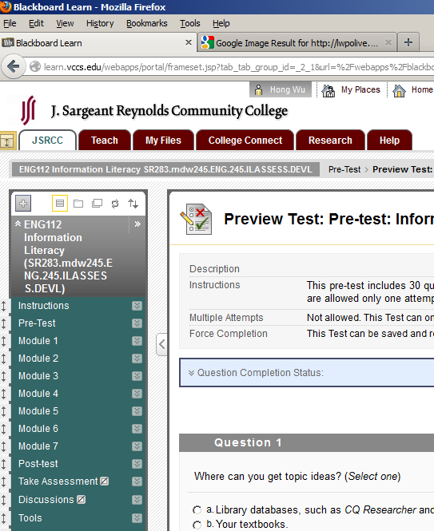
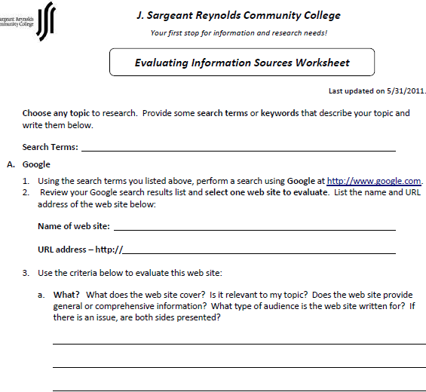
Information Literacy Assessment
Multiple Choice Questions via Bb
Open-ended Questions via Worksheets

Slide 18
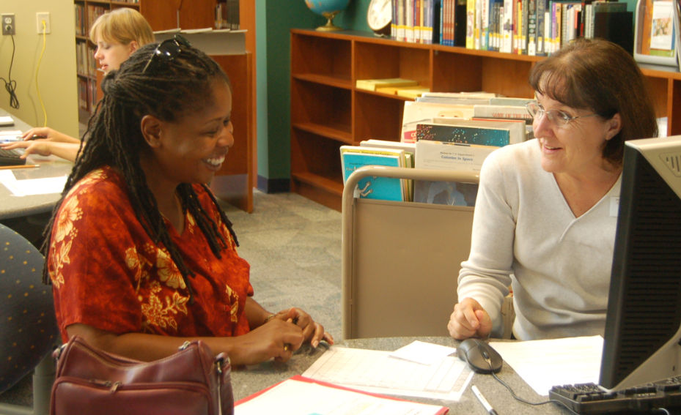
More from us…
Professional Development Opportunities (PDO)
Integrating Web 2.0 Into the Classroom
Beyond the Textbook: Integrating Library Resources into Your Blackboard Courses
Stay tuned for:
Apps. for Information Literacy
How to Create LibGuides
One on One Research Consultation
Group Study Rooms for collaborative projects

Slide 19

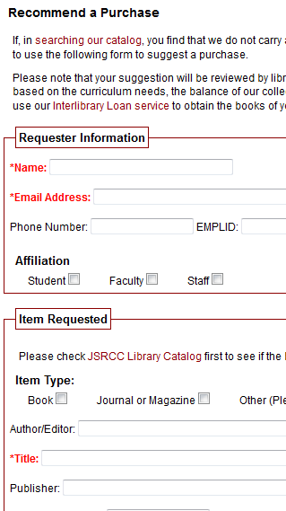
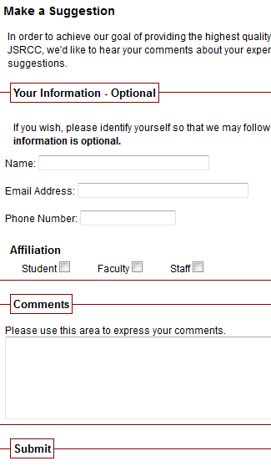
We welcome your feedback!
Notes:
Photo:http://www.kinesissurvey.com/kinesis-survey/customer-employee-feedback/

Slide 20

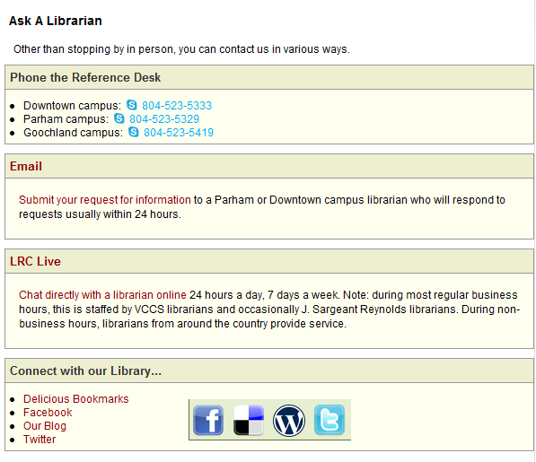
How to stay connected with us?

Slide 21
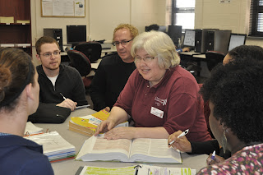
What can you do to help us?
If you have a special assignment that needs a special collection, discuss it with a librarian first.
Submit your library instruction request at least one week in advance.
Fill out the Assignment Alert form.
Put a copy of your textbook or required reading on Reserve.
Create assignments that would require your students to use library resources.
Contact a library liaison for collaborative projects…

Slide 22

Library Liaisons
Denise Woetzel (dwoetzel@reynolds.edu)
School of the Humanities, Social Sciences & Education
Khalil Ahmed (kahmed@reynolds.edu)
School of Nursing & Allied Health:
Maureen Hady (mhady@reynolds.edu)
School of Business & Engineering
Amanda Hartman (ahartman@reynolds.edu)
School of Mathematics & Sciences

Slide 23
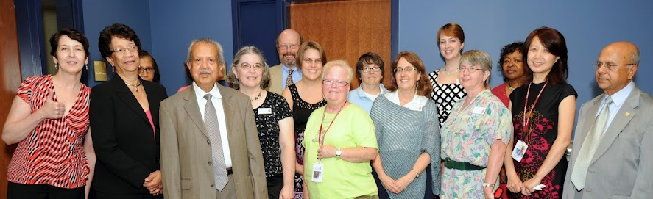
Thank You!
image from Flickr User eloquentlight's photostream
We are looking forward to working with you!
http://library.reynolds.edu

Slide 24
Customized Instruction Sessions
Package 1
Package 2
Package 3
Topic Ideas
Package 4
Finding Books
Reading a Call #
Finding Articles
Search Strategies
Remote Access
Journal Locator
Internet v. Library Database
Package 1 plus
More databases
Journals vs. Magazines
MLA or APA citation
Packages 1 & 2, plus:
Evaluating Information
Avoiding Plagiarism
Or Library Tour, etc
For special research assignments - we deliver what you request.
Customized Course Guides
Handouts & Worksheets

Slide 25

Links
Library: http://library.reynolds.edu
Faculty Services Guide: http://libguides.reynolds.edu/faculty
Notes:
Photo: http://www.flickr.com/photos/13606325@N08/2416993706/

